Slide 1





Welcome to the international course on
Science Communication for Societal Impact
14-18 September, hosted online from Delft

Slide 2


Science Communication for Societal Impact
14-18 September 2020
DAY 1
#SciCom20
@AesisNet

Slide 3
Science Communication for Societal Impact
14-18 September 2020
THE TEAM
Anika Duut van Goor – Director
Jelmer Gerritsen – Project Manager
Lonneke Tielrooij – Conference manager
Louis Roijmans – Project Manager
Donna van Eerd – Project Manager

Slide 4
Science Communication for Societal Impact
14-18 September 2020
ZOOM
Video lay-out:
Active speaker
Gallery view
Shared screen
Pin video
Tools:
(Un)mute
Chat box
Break out rooms

Slide 5
Science Communication for Societal Impact
14-18 September 2020
OVERVIEW OF AESIS
The AESIS network was founded in 2015 with the aim of creating an international, open community for various types of professionals working on stimulating and demonstrating the impact of science on economy, culture and well-being.

Slide 6
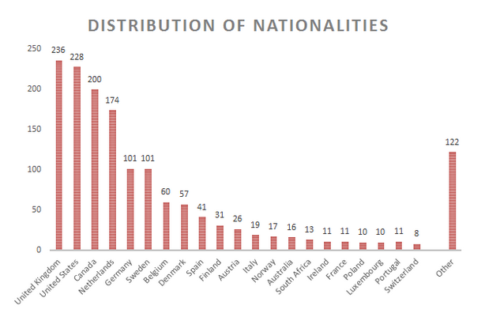
Science Communication for Societal Impact
14-18 September 2020
OVERVIEW OF AESIS
The AESIS network was founded in 2015 with the aim of creating an international, open community for various types of professionals working on stimulating and demonstrating the impact of science on economy, culture and well-being.

Slide 7
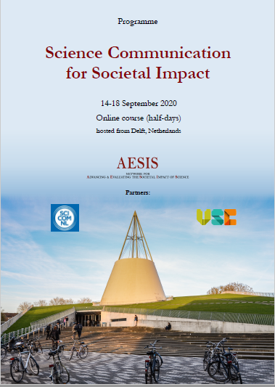
Science Communication for Societal Impact
14-18 September 2020
Monday 14 September – Welcome and introduction to Science Communication for Impact
Joost Ravoo & Roy Meijer, and Paul Manners
Tuesday 15 September – Science communication, university strategies, obstacles and criteria
Maarten van der Sanden and Alex Verkade
Wednesday 16 September – Facilitating science communication to society and lessons learned from COVID-19
Cissi Askwall & Anna Maria Fleetwood, and Stefanie Molthagen-Schnöring
Thursday 17 September – Connecting Organisations for Societal Impact and Public & Policy Engagement
Ben Vivekanandan and Emily Jesper
Friday 18 September- Science Gallery Rotterdam: Science Communication for Societal Impact
Fred Balvert
Case study presentations
OVERVIEW OF THE COURSE
#SciCom20

Slide 8
Science Communication for Societal Impact
14-18 September 2020
OVERVIEW OF THE PROGRAMME
Introduction
Opening of the course
by Joost Ravoo & Roy Meijer
General introduction participants
Paul Manners
Science Communication - Pathway to Societal Impact:
From communication to collaboration: public engagement
How to increase the change of effective impact through public engagement
The importance of evaluation and evidence of change

Slide 9
Science Communication for Societal Impact
14-18 September 2020
QUESTIONS?

Slide 10
Science Communication for Societal Impact
14-18 September 2020
Roy Meijer
Science Information Officer at Delft University of Technology
Joost Ravoo
Director of Marketing & Communication at Delft University of Technology

Slide 11
Welcome to TU Delft!
Science Communication
for Societal Impact
AESIS course 14-18 September 2020

Slide 12
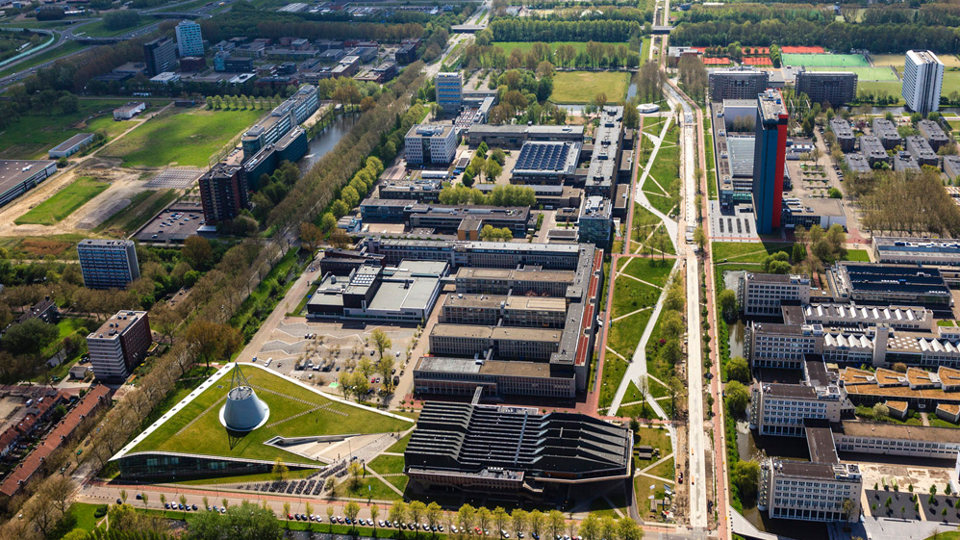
Notes:
Our 8 faculties offer 16 bachelor's and more than 30 master's programmes. Our more than 25,000 students and 6,000 employees share a fascination for science, design and technology. Our common mission: impact for a better society.

Slide 13
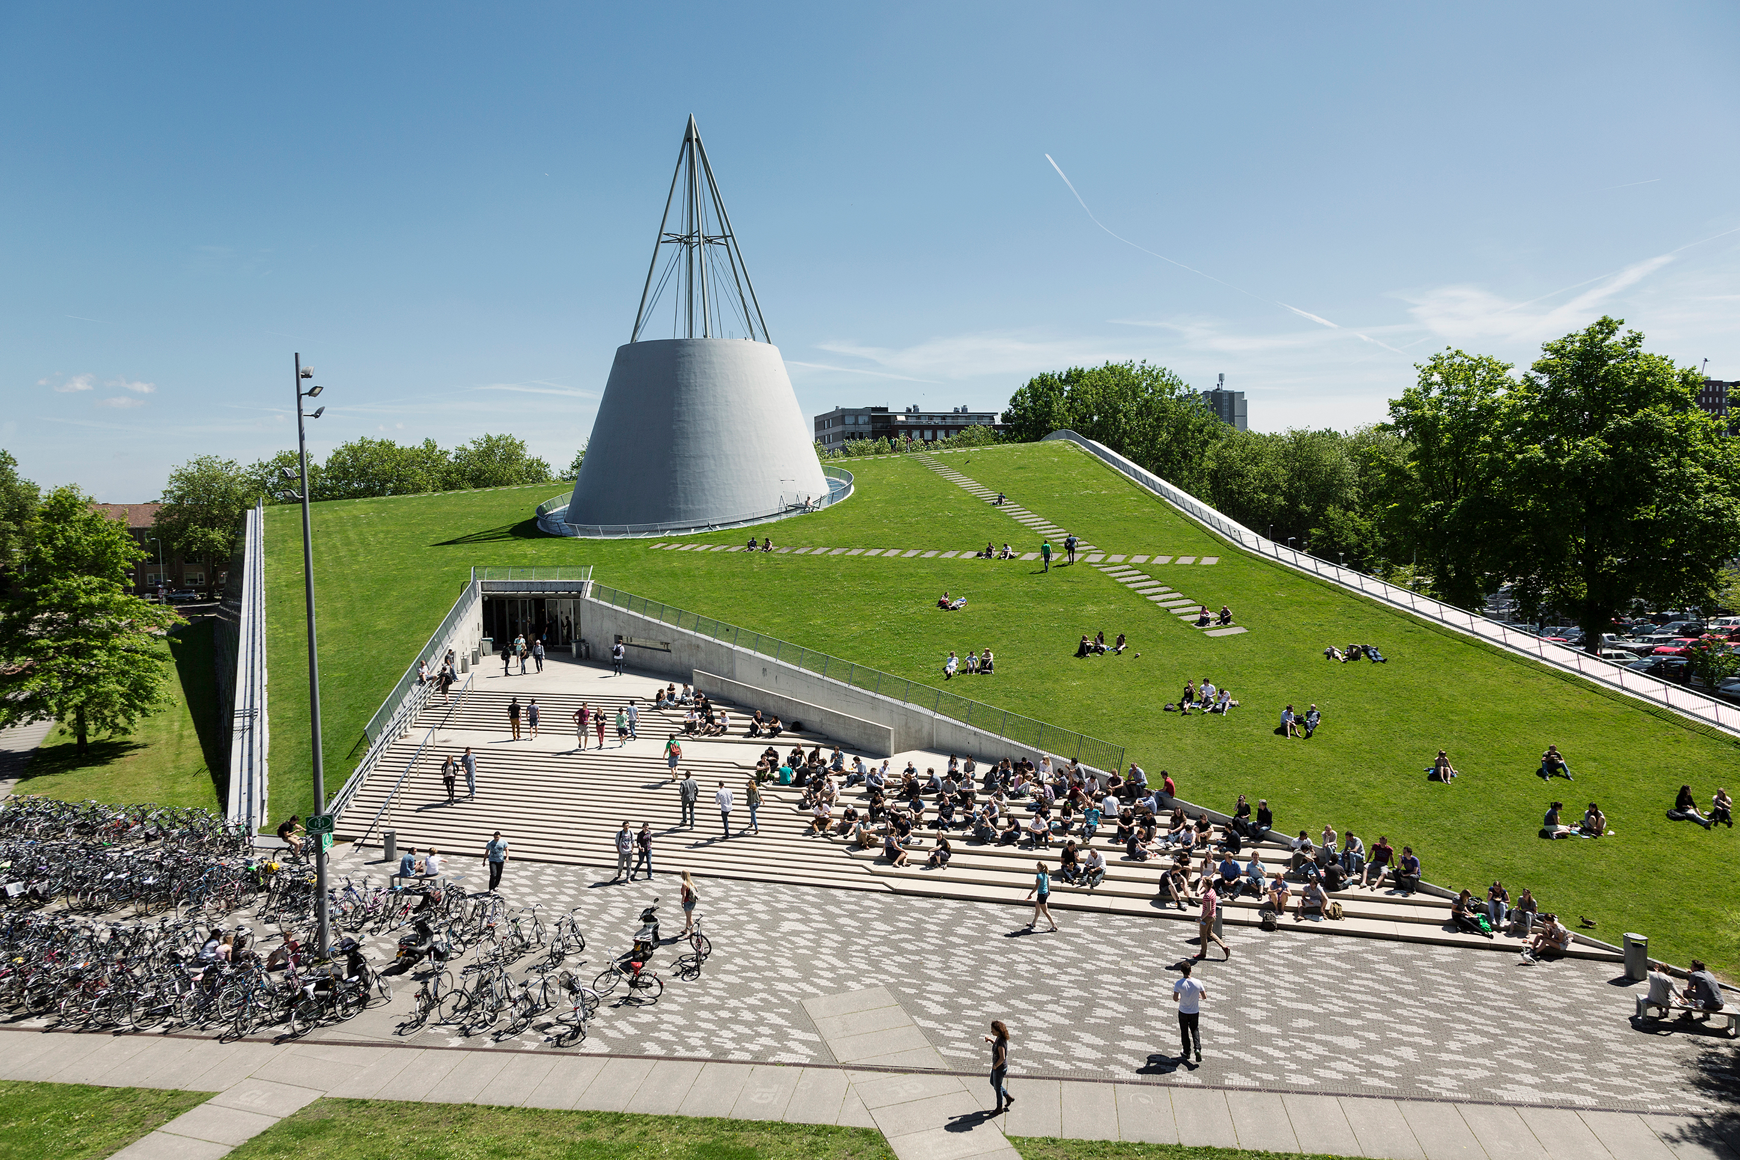
Notes:
Communication department, central office located in Tu Delft Library, here in busier times…

Slide 14
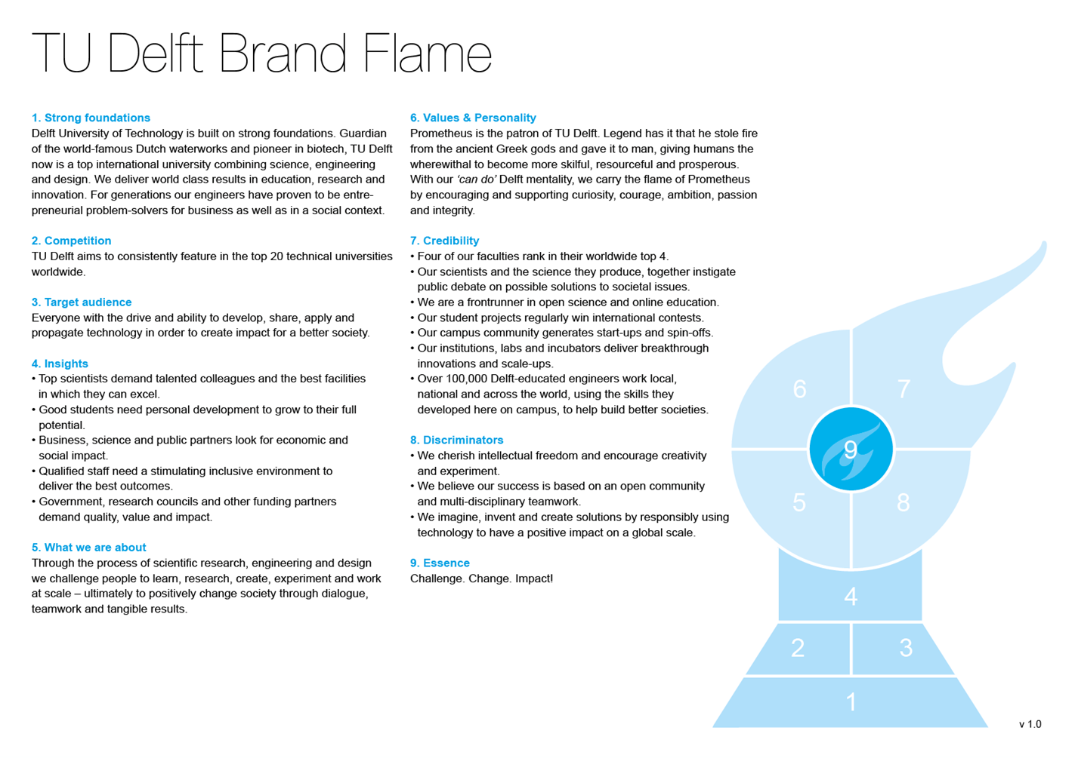
Challenge. Change. Impact!
Notes:
The way we look at our brand. In redefining the way we work also internal communication, and student journey as issues we are tackling right now. Als external communication, or science communication. Focus in Delft less on ‘science in society’, more on B2B, politics, partnerships.

Slide 15





WHY
(Impact for a
better Society)
Health & Care
Energy Transition
Digital Society
Climate Action
Urbanisation & Mobility
HOW
(Challenge
& Change)
Multi-disciplinary | Open | Creative
WHAT
(Science,
Engineering
& Design)
ABE
AE
AS
CEG
EEMCS
IDE
3mE
TPM
Institutes, QuTech, fieldlabs, DRI’s, LDE, etc
Notes:
And the way we tackle communicating about science centred around five themes #workinprogress. Increase impact by making working together in teams comprised of different parts of uni, developing strategy, making explicit ambition(s), defining related target groups. Also self-preservation > so much going on at TU Delft, helps to focus.

Slide 16
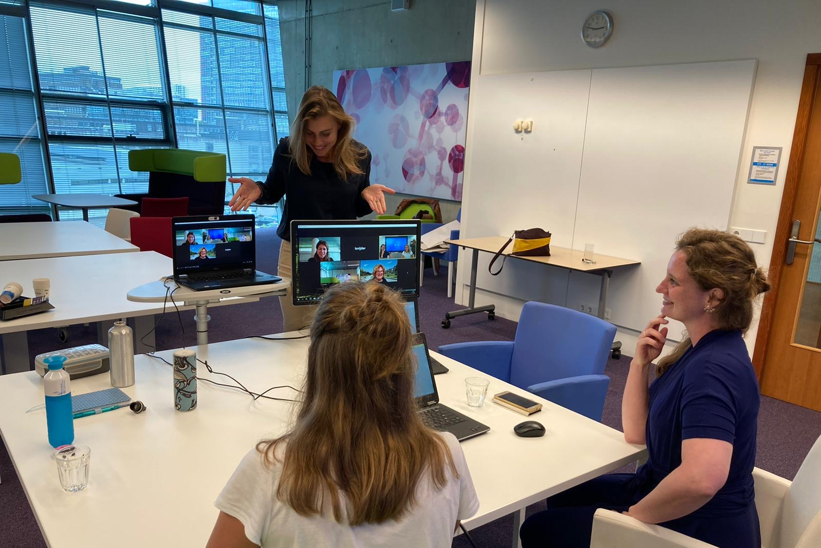
Notes:
Media training one of the ways we invest in making our scientists and students communicate better with media. Here session for students in same room we are now. In the last few years we’ve trained over 1.000 scientists, building up a large network and a great reputation for the team within TU as we went along. For a long time corner stone in our

Slide 17
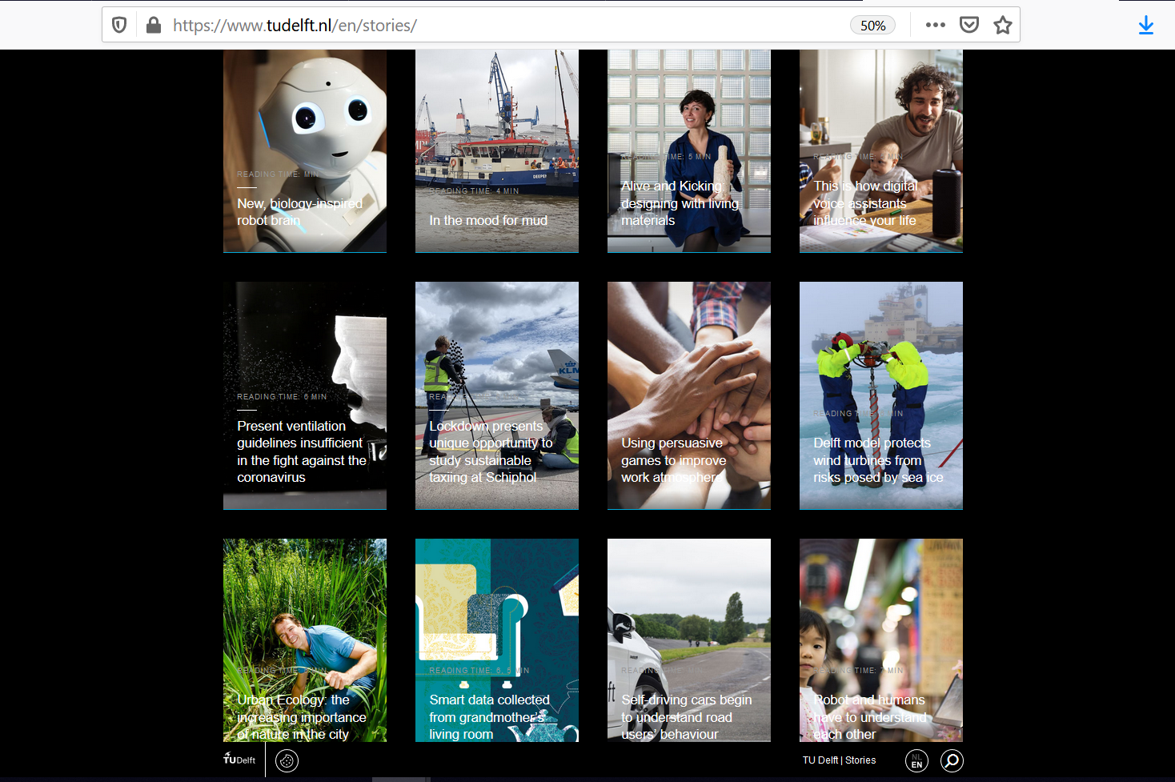
Notes:
Story platform recent development, online November last year. Press release vs story, emphasis on process, the actual work, and the person behind the scientist, motive,. Proud of this platform.
Impact: through campaigns around a theme, like circular economy, or the SDGs, but also individual: when scientists proudly share their story on LinkedIn.

Slide 18
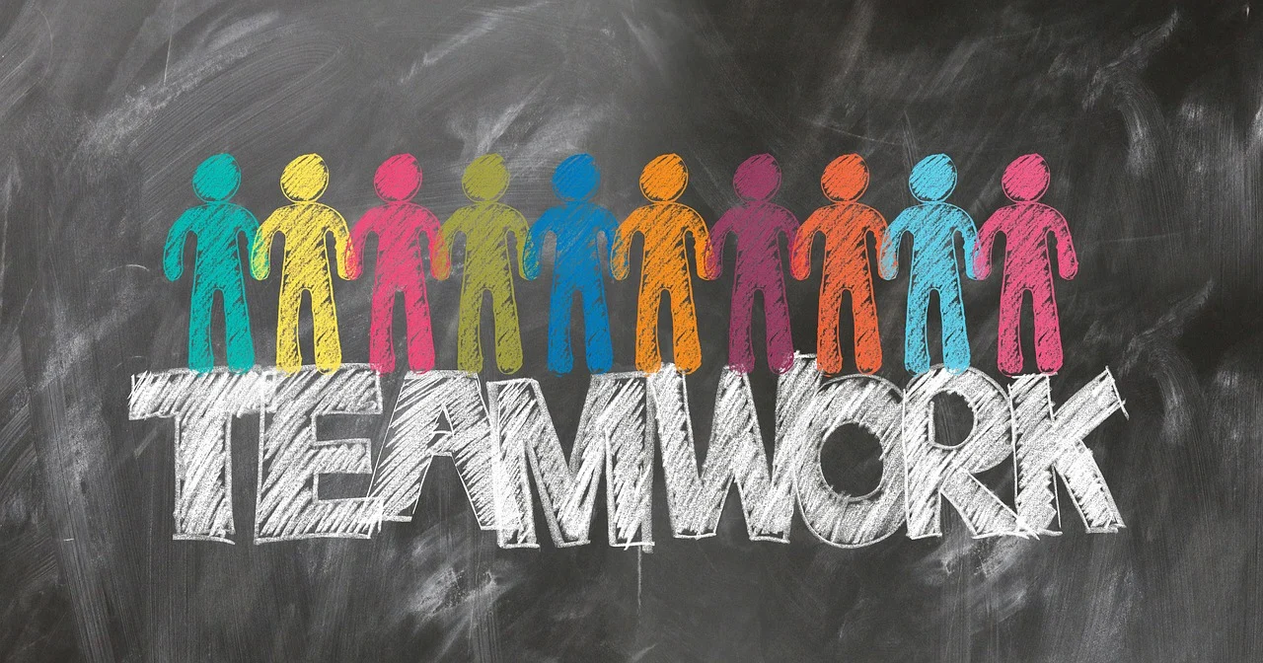
Notes:
Also proud of the way we built this up, implemented it and run this platform as grass roots, bottom up initiative.
Stepping stone for expanding scope from just stories to include other means like press rfelease, and even live stories.

Slide 19
Impact of our stories
Cijfers per 30 dagen interval | Mrt-Apr |  | Apr-Mei |  | Mei-Juni |  | Juni-Juli |  | Juli-Augustus
Totaal bezoek | 5029 |  | 4217 |  | 4075 |  | 7498 |  | 4819
Mobiel vs. Desktop | Mob: 2450 | Desk: 2500 | Mob: 1875 | Desk: 2250 | Mob: 1984 | Desk: 2018 | Mob: 4592 | Desk: 2691 | Mob: 2852 | Desk: 1772
Top 3 verhalen NL | Aandacht voor eenzame jongeren in (641 (!)) |  | We/Visit (436) |  | Maakt wandelen en fietsen je gelukkig en gezond? (219) |  | Huidige ventilatierichtlijnen niet voldoende in strijd tegen corona (4173) !!! |  | Huidige ventilatierichtlijnen niet voldoende in strijd tegen corona (2858)
 | Een beetje wiskunde voor het bestrijden van epidemieën (308) |  | Een samenleving na corona (312) |  | Koelen met magneten voor een groenere wereld (176) |  | Zee-ijs geen vat op windturbine dankzij Delfts model (261) |  | Leven en laten leven: ontwerpen met biomaterialen (135)
 | Hoe geen energie verspillen aan 5G (288) |  | Burgers betrekken bij duivelse beleidsdilemma’s (305) |  | Het masker ontmaskert (172) |  | Urban Ecology: natuur in de stad steeds belangrijker (184) |  | Zo veel meer dan 3D visualisatie (96)
Top 3 verhalen Eng | Recycling mouth masks (1227+428 (!) VIDEO) |  | We/Visit (666) |  | Magnetic cooling for a cleaner world (1160)!!! |  | Alive and Kicking: designing with living materials (544) |  | Present ventilation guidelines insufficient in the fight against the coronavirus (337)
 | A revolution in modelling travel behaviour (254) |  | A post-corona society (247) |  | Evacuating virtual buildings (373) |  | Urban Ecology: the increasing importance of nature in the city (419) |  | New, biology inspired robot brain (215)
 | A post-corona society (217) |  | A fresh perspective on potato growth (232) |  | Student volunteers offer help in times of corona (251) |  | Present ventilation guidelines insufficient in the fight against the coronavirus (364) |  | Understanding Noise – from quantum fluctuations to climate models (197)
Herkomst IP adres traffic | NL: 72,7% |  | NL: 75% |  | NL: 72,5% |  | NL: 77,8% |  | NL: 74,3%
 | Non-NL: 27,3% |  | Non-NL: 25% |  | Non-NL: 27,5% |  | Non-NL: 22,2% |  | Non-NL: 25,7%
Lead-in traffic | Direct: 1600 |  | Direct: 1450 |  | Direct: 1400 |  | Direct: 3400 |  | Direct: 1450
 | Socials: 1175 |  | Socials: 750 |  | Socials: 1000 |  | Socials: 2450 |  | Socials: 1500
 | Search engine: 550 (!) |  | Search engine: 525 (blijft toch hoog) |  | Search engine: 425 |  | Search engine: 500 |  | Search Engine: 650
Herkomst traffic socials | LinkedIn: 560 |  | Linkedin: 355 |  | LinkedIn: 495 |  | LinkedIn: 1275 |  | LinkedIn: 425
 | Facebook: 450 (!) |  | Facebook: 285 |  | Facebook: 445 |  | Facebook: 625 |  | Facebook: 1000
 | Twitter: 200 |  | Twitter: 100 |  | Twitter: 110 |  | Twitter: 550 |  | Twitter: 100
Time on page | Unknown (1 pageview): 2600 |  | Unknown: (1 pageview): 2175 |  | Unknown (1 pageview): 2300 |  | Unknown (1 pageview): 5300 |  | Unknown (1 pageview): 3150
Doorkliks naar 2e pagina | 120 |  | 95 |  | 90 |  | 125 |  | 90
Notes:
Started keeping track, simple Google Analytics.
Content -> reach -> interaction -> transaction -> impact in society

Slide 20
Science Communication for Societal Impact
14-18 September 2020
Break
We will be back at 10.00 (GMT+2)
#SciCom20

Slide 21
• Facilitators •
• Businesses •
• KTO’s •
Business creation
Business development
Industry
Government
Citizens
• Management •
• Startup’s •
• Funding agencies •
Universities
(and other Research institutions)
• Research Councils •
• Policy makers •
Science
Data & Evidence for Policy
Science Policy
Society
• Science policy makers •
• Researchers •
• Societal organisations •
• Administrators •
Knowledge dissemination
Citizen Science
• Media •
• Scientometricians •
• Consumers •
• Evaluators •
• Investors •
Notes:
The impact-landscape as a whole – all types of stakeholders you could possibly contact/work with. Where would we place science communication?

Slide 22
Science Communication for Societal Impact
14-18 September 2020
Where do you sit in the ecosystem of research activity? Why are you here, and what do you want to take away?

Slide 23
Science Communication for Societal Impact
14-18 September 2020
Are science communication and societal impact integrated in the (research) strategy of your institution?

Slide 24
Science Communication for Societal Impact
14-18 September 2020

Slide 25
Science Communication for Societal Impact
14-18 September 2020
CASE STUDY EXERCISE
A proposal to improve the societal impact of your institute
by integrating effective science communication methods and tools
Schedule
Session 1 – Monday 14 September
Introduction to the course exercise
Session 2 – Wednesday 16 September
Group discussion about the stakeholders that need to be involved, internally and externally:
Identify stakeholders with respect to achieving your goals
Discuss the different benefits from the perspectives of the different stakeholders
How to address the stakeholders and convince them to be involved (aka communication for science communication)
Session 3 – Friday 18 September
Everyone presents their plan in a (powerpoint) presentation of 5 minutes, followed by a brief Q&A

Slide 26
Science Communication for Societal Impact
14-18 September 2020
Break
We will be back at 11.10 (GMT+2)
#SciCom20

Slide 27
Science Communication for Societal Impact
14-18 September 2020
Paul Manners
Founding Director of the National Co-ordinating
Centre for Public Engagement

Slide 28
Science Communication for Societal Impact
14-18 September 2020
Thank you
Enjoy lunch!
#SciCom20

Slide 29
Science Communication for Societal Impact
14-18 September 2020
Monday 14 September – Welcome and Introduction to Science Communication for Impact
Joost Ravoo & Roy Meijer, and Paul Manners
Tuesday 15 September – Science communication, university strategies, obstacles and criteria
Maarten van der Sanden and Alex Verkade
Wednesday 16 September – Facilitating science communication to society and lessons learned from COVID-19
Cissi Askwall and Anna Maria Fleetwood and Stefanie Molthagen-Schnöring
Thursday 17 September – Connecting Organisations for Societal Impact and Public & Policy Engagement
Ben Vivekanandan and Emily Jesper
Friday 18 September- Science Gallery Rotterdam: Science Communication and Societal Impact
Fred Balvert
Case study presentations
OVERVIEW OF THE COURSE
#SciCom20

